Slide 1
Multimedia Hardware

Slide 2
a. Input Devices
A great variety or input devices from the familiar keyboard and handy mouse to touchscreens and voice recognition setups can be used for development and delivery or a multimedia project.

Slide 3
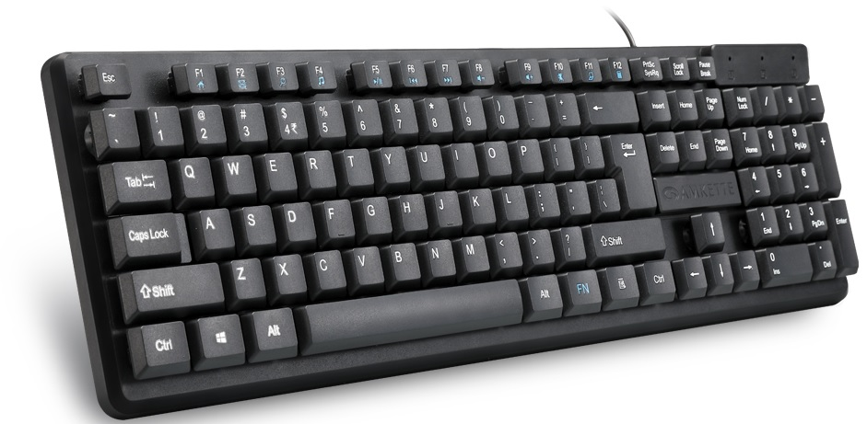
Keyboard
A keyboard is the most common method of interaction with a Computer. Keyboards provide various tactile responses and have various layout depending upon your Computer system and keyboard model. Keyboard is typically rated at least 50 million cycles.
The most common keyboard for PCs is the 101 style, although many styles are available with one or more special keys, LEDs, and other features.
Wired
Wireless

Slide 4
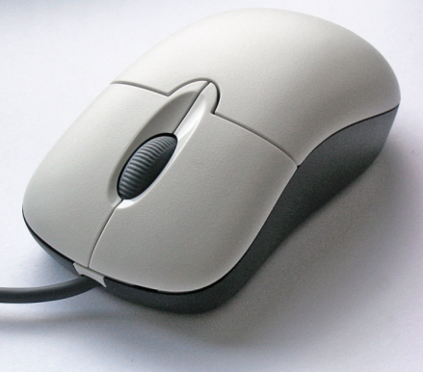
Mouse
A mouse is the standard tool for interacting with a graphical user interface (GUI). All Macintosh computers require a mouse; on PCs, mice are not required but recommended. The buttons on the mouse provide additional user input, such as pointing and double clicking to open a document, or the click –and-drag operation.
Standard Apple mouse has one button: PC mice may have as many as three.

Slide 5
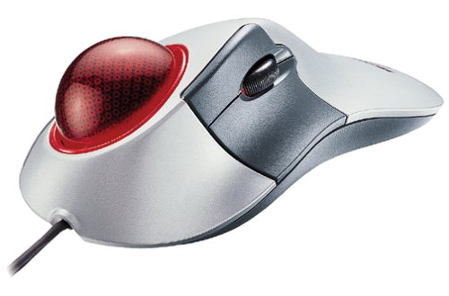
Track Ball
Track ball are similar to mice except that the cursor is moved by using one or more fingers to roll across the top of the ball. The track ball does not need the flat space required by a mouse. Track ball have at least two buttons; one for the user to click or double-click, and the other to provide the press and hold condition necessary for selecting from menus & dragging objects.

Slide 6
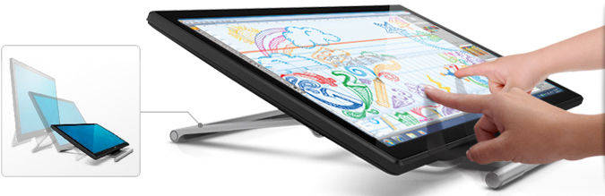
Touch Screens
Touch screens are monitors that usually have a textured coating across the glass face. This coating is sensitive to pressure and register the location of the user’s finger when it touches the screen.
The TouchMate system, which has no coating, actually measures the pitch, roll, and yaw rotation of the monitor when pressed by a finger, and determine how much force was exerted and the location where the force was applied.

Slide 7
Touch Screens contd..
Other touchscreens use invisible beams of infrared light that crisscross the front of the monitor to calculate where a finger was pressed.

Slide 8
Magnetic Card Encoders And Readers
Magnetic(mag) card setups are useful when you need an interface for a data- base application or multimedia project that tracks users. You need both a card encoder and a card reader for this type of interface. The encoder connects to the computer at a serial port and transfers information to magnetic strip of tape on the back of the card. The reader then reads the information encoded on the card.
This is a common method for reading credit card information and connecting it to your bank account.

Slide 9
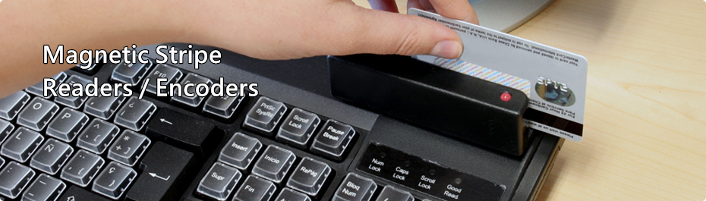

Slide 10
Graphics Tablets
Flat-surface input device.
Special Pen against the pressure-sensitive surface.
Tablets can also be used as input devices for end users: you can design a printed graphics, place it on the surface of the tablet, and let users work with a pen directly on the input surface.
Harder you press the stylus, the wider or darker the line you draw.

Slide 11
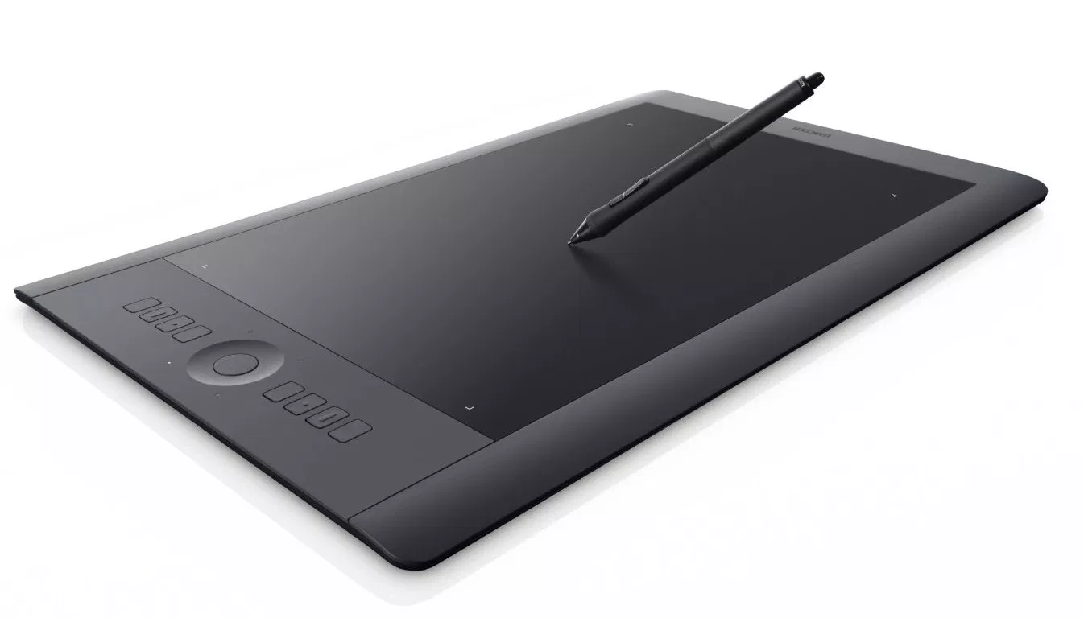

Slide 12
Scanners
A scanner may be the most useful piece of equipment you will use in the course of producing a multimedia project. There are flat-bend scanner, handheld scanners and drum scanners. Most commonly available are color flat- bed scanners that provide a resolution of 600 dots per inch(dpi) or better. Professional graphics houses may use even higher resolution drum scanners.
Hand-held scanners can be useful for scanning small images and columns of text.

Slide 13
Scanners contd..
Drum scanner A form of document scanner where the original document to be scanned is wrapped around a drum and then scanned by moving the detector head longitudinally as the drum is rotated. Drum scanners are used where the highest resolution is required, as in scanning high-quality photographs for print reproduction.

Slide 14
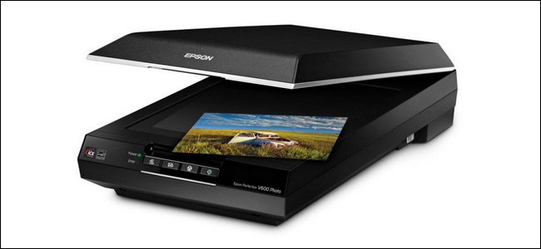
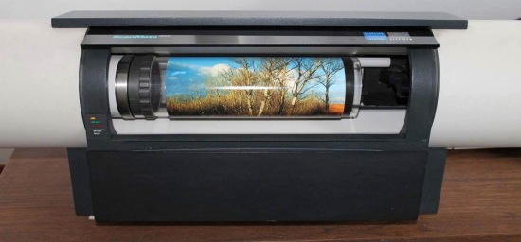
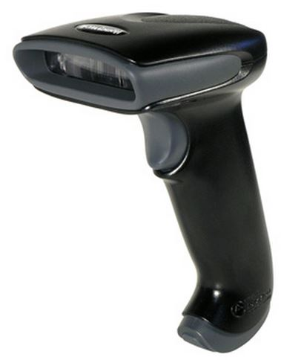

Slide 15
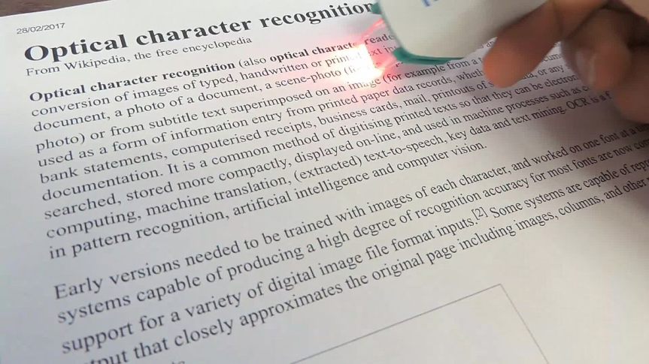
OPTICAL CHARACTER RECOGNITION (OCR) DEVICES
OCR sofware, such as OmniPage from ScanSoft to convert printed matter to ASCII text files in our computer. We can also convert paper document into a word processing document on our computer without retyping or rekeying. An OCR terminal can be of use to multimedia developer because it recognizes not only printed characters but also handwriting.
Example: Barcode reader.

Slide 16
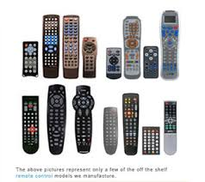
Infrared Remotes
An infrared remote unit Iets a user interact with our project while we are freely moving about. Remotes work like mice and trackballs, except they use infrared light to direct the cursor and require no cables to communicate. Remote mice work well for a Iecture or other presentation in an auditorium or similar environment, when the speaker needs to move around the room.

Slide 17
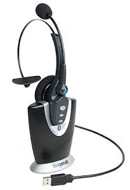
Voice Recognition System
Voice recognition system facilitates hands free interaction with your project. These system usually provide a unidirectional cardiod, noise canceling microphone that automatically filters out background noise. Most voice recognition system currently available can trigger common events such as Save, Quit, Open, Print etc and you can teach the system to recognize other commands. The Macintosh AV and Power Macintosh computer include voice recognition capability and add on sound board such as the Sound blaster or Diamond Sonic Sound and other provide this features for PCs.

Slide 18
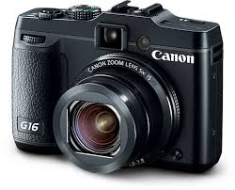
Digital Camera
Digital Camera use the same technology i.e. CCD as video camera uses. They capture the still images of a given no. of pixels and the images are stored in camera's memory to be uploaded later to a computer. The higher the mega pixel rating, the higher the resolution of camera. Images are uploaded from the camera's memory using a serial, parallel, or USB cable or alternatively, the camera’s memory card is inserted into a PCMCIA (Personal Computer Memory Card International Association) reader connected to the computer.

Slide 19
b) Output Devices
Presentation or the audio and the visual components of our multimedia project requires hardware that may or may not be included with the computer itself- speakers, amplifiers, monitor, motion video devices, sound recorders and capable storage systems. There is no greater test of benefit of good output hardware than to feed the audio output of your computer into an external amplifier.

Slide 20
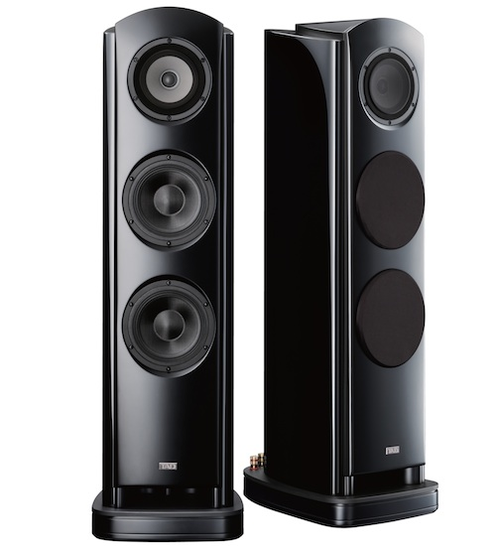
AUDIO DEVICES
All Machintoshes are equipped with an internal speaker and a dedicated sound chip and they are capable of audio output without additional hardware and /or software. To take advantage of built in stereo sound, external speakers are required.
Digitizing sound on your Machintosh requires an external microphone and sound editing/recording software such as Sound edit 16 from Macromedia, Sound Forge.

Slide 21
Amplifiers And Speakers
Often the speakers we use during a project development will not be adequate for its presentation. Speakers with built in amplifier are important when our project will be presented to a large audience or in a noisy setting.
Atlec Lansingh’s three-piece amplified speaker system ,is designed for multimedia presentations and is small and portable.

Slide 22
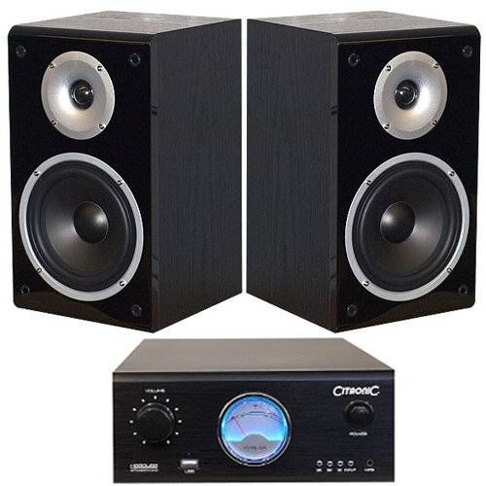

Slide 23
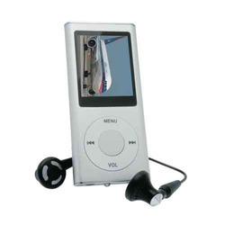
Portable Media Players
It is a hard disk or flash memory-based electronic device that may be used for audio, video, digital images and other media formats.
Ipod players by Machintosh are very prevalent among school age people.

Slide 24
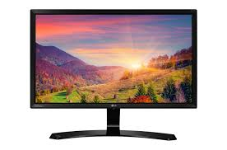
Monitors
The monitors we need for development of multimedia projects depend on the type of application we are creating. A wide variety of monitors are available for both Machintosh and PCs. High-end, large screen graphics monitors and LCD panels are available for both, and they are expensive.
Serious multimedia developers will often attach more than one monitor to their computers, using add-on graphics boards. This is because many authoring system allow us to work with several open windows at a time so we can dedicate one monitor to viewing the work we are creating or designing and can perform various editing tasks in windows on other monitor that do not block the view of work.

Slide 25
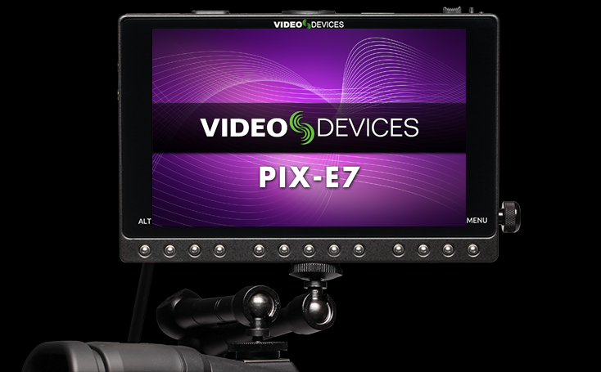
Video Devices
Message medium has the visual impact of video with a video digitizing board installed in computer, can display a television picture on monitor. Some boards include frame-grabber features for capturing the images and turning it into a color bitmap, which can be saved as a PICT or TIFF file and then used as a part of a graphics or a background project.

Slide 26
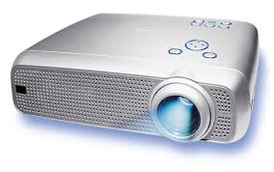
Projectors
When we need to show material to more viewers that can huddle around a computer monitor, we will need to project it onto a large screen or even a white painted wall. Cathode-ray tube projectors, liquid crystal display (LCD) panel attached to an overhead projector, stand alone LCD projectors, and Granting-Light-Valve projectors are available to splash work onto big screen surfaces.

Slide 27
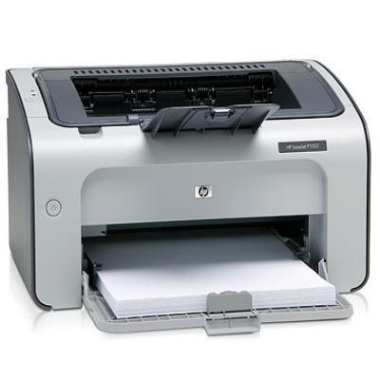
Printers
With the advent of reasonably priced color printers, hard copy output has entered the multimedia scene. From storyboards to presentation to production of collateral marketing material, color printers have become an important part of the multimedia development environment. Color helps clarify concept, improve understanding and retention or information, and organize complex data. Xerox offers both solid ink and laser options.

